Slide 1
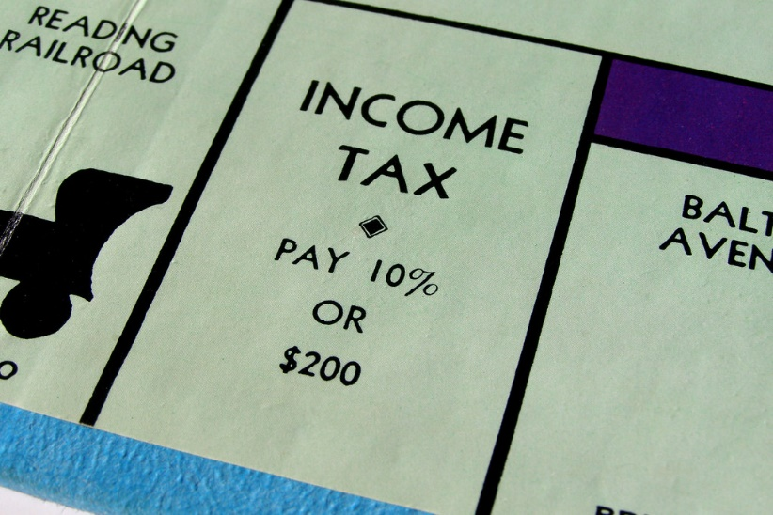
Why we need taxes

Slide 2
History of Taxes:
What is tax?
Activity 1: Define Taxes – compile a definition for your notes
Activity 2: Think about Taxes
Think of a time when you heard someone talking about taxes
What did the person say about taxes?
How did they feel about it, and how do you know?
Why do people pay taxes?

Slide 3
History of taxes in Canada
Canada’s tax system has evolved over many years to accommodate the needs of an increasingly complex society.
The tax system needs to benefit all Canadians and should be flexible so the government can use it to achieve specific social and economic objectives.
Tax Legislation:
In small groups, read and discuss the information in a think-pair-share, then present to the class.
Tax Administration:
In small groups, read and discuss the information in a think-pair-share, then present to the class
Canada’s Tax System Worksheet for above Think-Pair-Share.

Slide 4
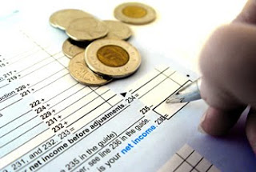
History of taxes in Canada
Milestones in Canadian Taxation:
Segments 1 – 10:
Click here
Instructions:
Share the facts from the strips (in numerical order) to give the class a brief overview of the history of taxation in Canada.

Slide 5
History of taxes in the world
Since the beginning of recorded history, a tax system of some kind has always existed in organized societies and governments. Over 3,500 years ago, the ancient Egyptians collected taxes and the Roman Empire had a highly evolved tax system.
The French and Romans of the 13th century were credited with the first use of a word similar to tax. The French had taxer and the Latin used taxare to describe the acts: to estimate, to assess, or to touch repeatedly.
Discussion:
When did taxes first come into existence?
Why were taxes introduced?

Slide 6
History of taxes in the world
TAX TRIVIA:
Activity:
In pairs, from assigned segments from worksheet in below link,
read your assigned segment and
choose part of it to present to the class in a visual presentation such as
a captioned cartoon OR poster.
Segments 1 – 13: Click here

